Slide 1

School Financial Management Application
Revolutionizing school financial management with a user-friendly web application designed for seamless fee tracking and balance management.
pm
by paul masha

Slide 2

Streamlined Fee Balance Tracking
1
Real-Time Updates
Parents and administrators can access accurate fee balances in real-time, eliminating the need for manual checks.
2
Automated Notifications
Automated alerts for pending payments and outstanding balances, ensuring timely fee collection and improved financial transparency.
3
Detailed Reporting
Generate comprehensive reports on fee collection, outstanding balances, and financial trends, providing valuable insights for informed decision-making.

Slide 3
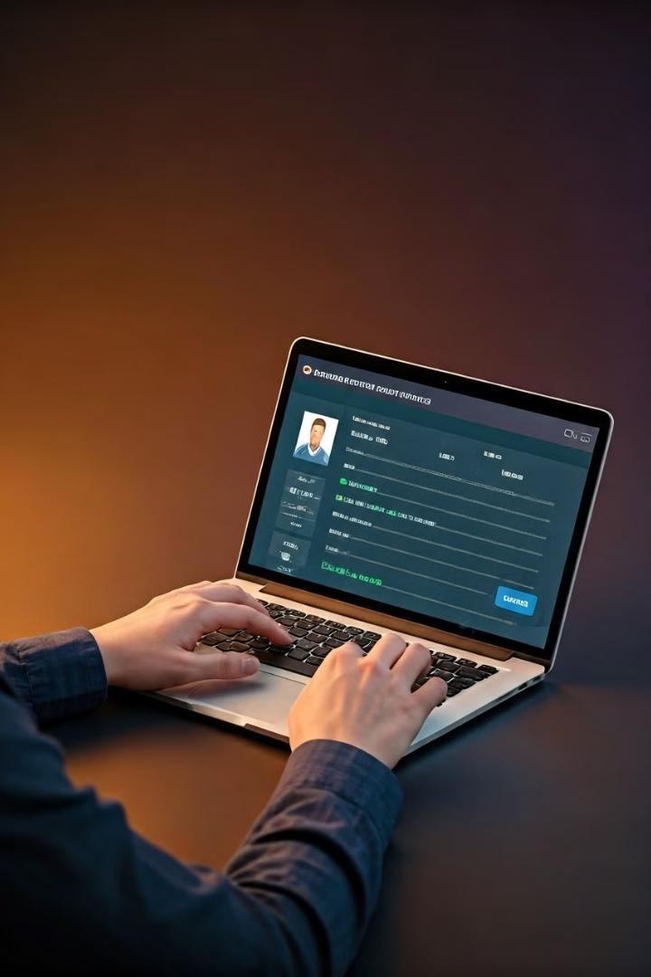
Effortless Fee Balance Checks
1
User-Friendly Interface
2
Simplified Search Functionality
Intuitive design makes it easy for users to navigate and access information, even for those with limited tech experience.
Quickly find student records and view their fee balances with ease, saving time and effort.
3
Mobile-Responsive Design
4
Instant Updates
Updates reflect the latest fee payments and adjustments, ensuring accuracy and consistency.
The application is accessible on any device, allowing users to manage fees from anywhere, anytime.

Slide 4

Target Market: Secondary Schools
Private Schools
Public Schools
Private schools often have complex fee structures and need efficient tools for managing student accounts.
Public schools benefit from transparent fee management, enhancing communication between parents, students, and administrators.

Slide 5
Competitive Landscape and Advantages
Current Challenges
Our Solution
Many existing applications require lengthy procedures for fee balance checks and statement generation, leading to inefficiencies and frustration.
Our application streamlines the process, offering real-time updates, automated notifications, and comprehensive reporting, making fee management effortless.

Slide 6



Business Model and Revenue Streams
Subscription Model
Schools pay a monthly or annual subscription fee to access the application's features, ensuring ongoing revenue.
Value-Added Services
Optional add-on services, such as customized reporting, integration with other school systems, and dedicated support, can generate additional revenue streams.

Slide 7
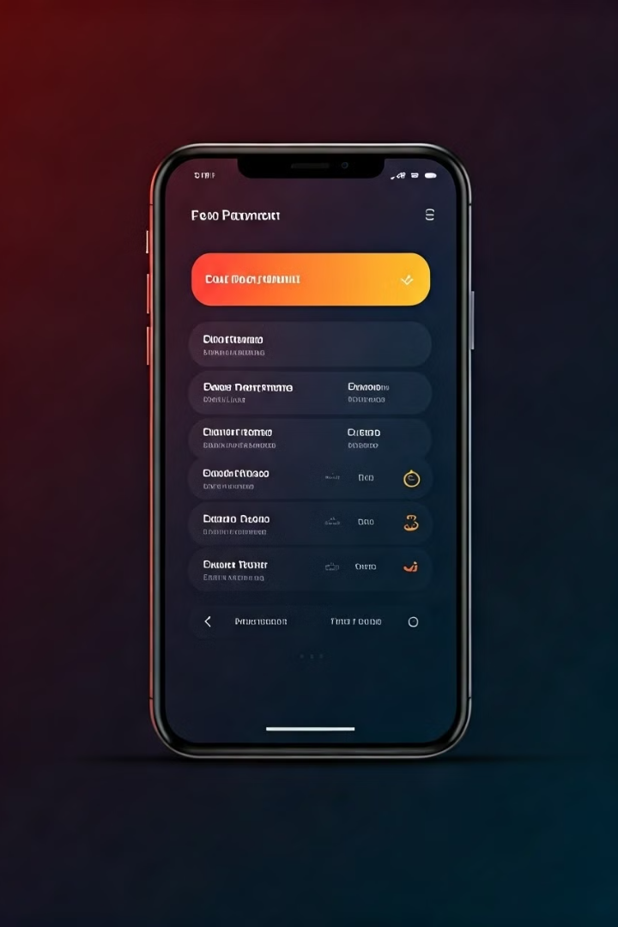



Traction and Key Milestones
Application Design
A user-friendly and intuitive interface is ready for launch, ensuring a smooth and enjoyable user experience.
Pilot Program
Successfully piloted with a select group of schools, gathering valuable feedback and refining the application for optimal performance.
Market Research
Comprehensive market analysis conducted to understand the needs and preferences of our target audience, informing future development efforts.

Slide 8

The Ask and Future Growth Plans
Objective
Action
Expand Reach
Develop a version suitable for tertiary institutions, attracting a wider customer base.
Enhance Functionality
Integrate the application with other school management systems, providing a comprehensive solution.
Innovation
Explore new features like online fee payment, automated financial reporting, and personalized student dashboards.

